Slide 1


Resume Match
A Job Description and Resume Matching System
Pavani Chella - G41309434
Yasaswitha Gaddam - G31728688

Slide 2


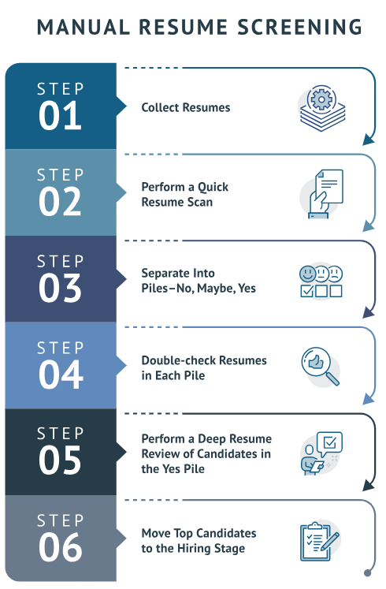

The Recruitment Challenge
Key Problems :
Recruiters often spend 23% of their time reviewing resumes manually
Manual review of resumes is time-consuming.
High volume of resumes leads to errors and bias.
Matching candidates to the right jobs can be inefficient.

Slide 3


What We Aim to Achieve
Introduce a system that automates and optimizes
the resume and job description matching process
Benefits :
Faster resume screening.
More accurate matches based on skill and experience.
Reduced recruiter bias.

Slide 4

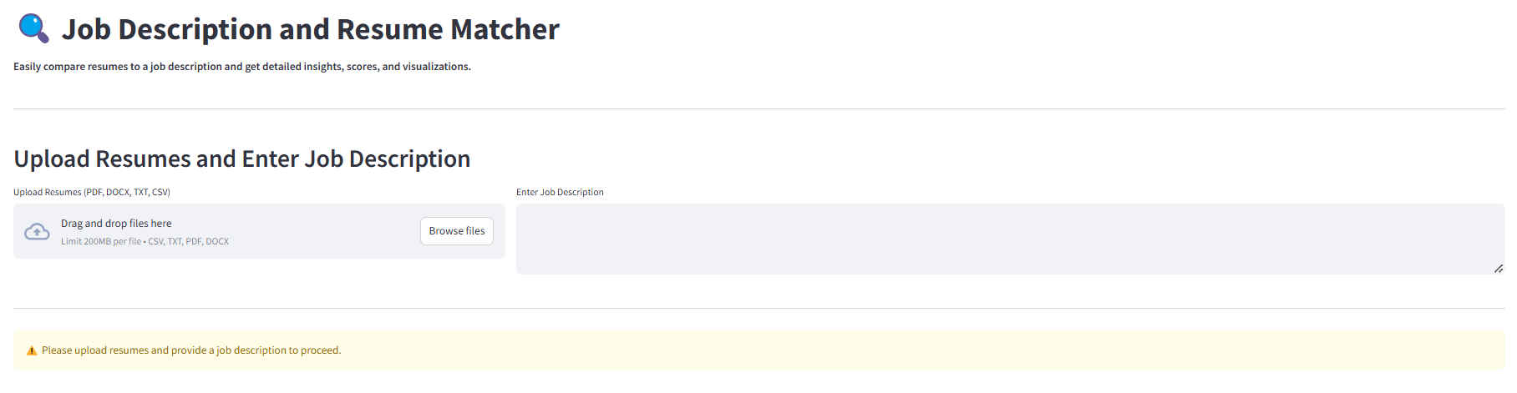

Interactive User Experience
An interactive web-based UI
Easy-to-use interface for uploading resumes (drag-and-drop).
Text area for job descriptions.
Visual results in the form of graphs, charts, and word clouds.
Real-time feedback on similarity scores and sentiment.

Slide 5


Robust Backend Features
Resume parsing for multiple formats (PDF, DOCX, TXT).
Keyword extraction and similarity scoring using NLP techniques.
Sentiment analysis for tone and intent detection.
Experience calculation based on extracted time frames.
Visualization of results (bar charts, pie charts, and word clouds)

Slide 6

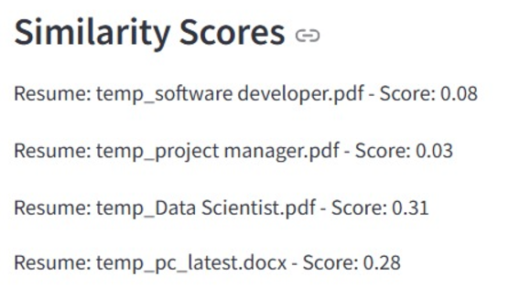
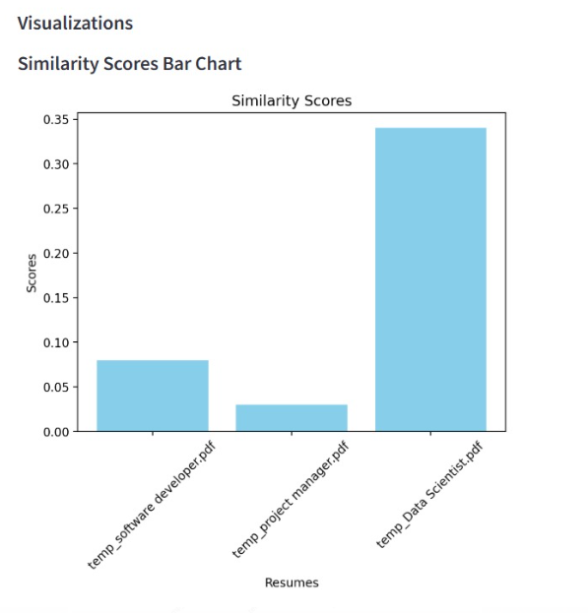
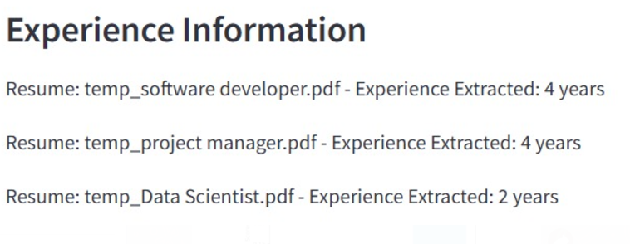
Key Features
1) Similarity Scores
2) Visualization
3) Experience information

Slide 7

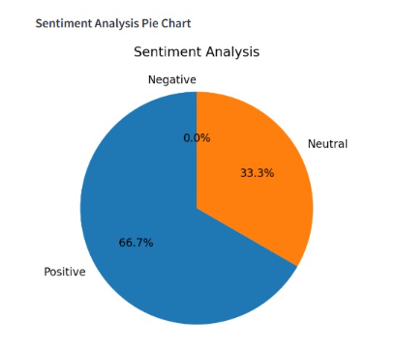
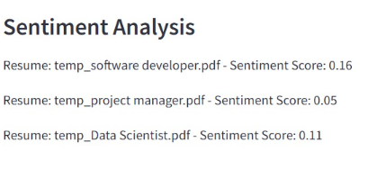
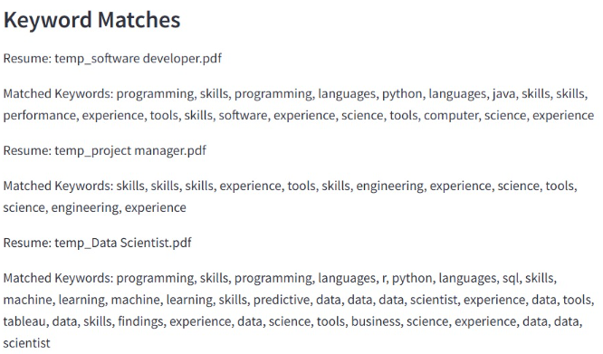
4) Sentiment Analysis
5) Keyword Matches

Slide 8



How it works?
Step 1: User uploads resumes and job descriptions.
Step 2: The tool processes the data using NLP and AI models.
Step 3: The system calculates similarity scores and extracts key skills.
Step 4: Results are displayed with visualizations, filters, and search options.

Slide 9



User Interface Demo

Slide 10

Results and Benefits for Users
Faster job recruitment process.
More accurate matching.
Better candidate-job alignment.
Enhanced user experience for recruiters and job seekers.

Slide 11


Limitations & Opportunities for Improvement
Limitations:
Dependent on job description quality.
Processing speed for extremely large datasets.
Limited to text-based resumes (no multimedia parsing)
Future Scope:
Multilingual Support: Process resumes and job descriptions in multiple languages.
Custom Weighting: Allow recruiters to prioritize certain skills.

Slide 12

Conclusion
This project harnesses the power of cosine similarity and NLP techniques to transform resumes into actionable insights.
By comparing resumes with job descriptions, we generate key metrics such as similarity scores, keyword matches, sentiment analysis, and experience extraction.
With intuitive visualizations, this tool provides job seekers with a clear and impactful way to fine-tune their resumes, ensuring they stand out and align perfectly with job requirements.
Ultimately, it empowers candidates to enhance their chances of success in today’s competitive job market.

Slide 13


